Slide 1
Bar stimulus 2.0

Slide 2
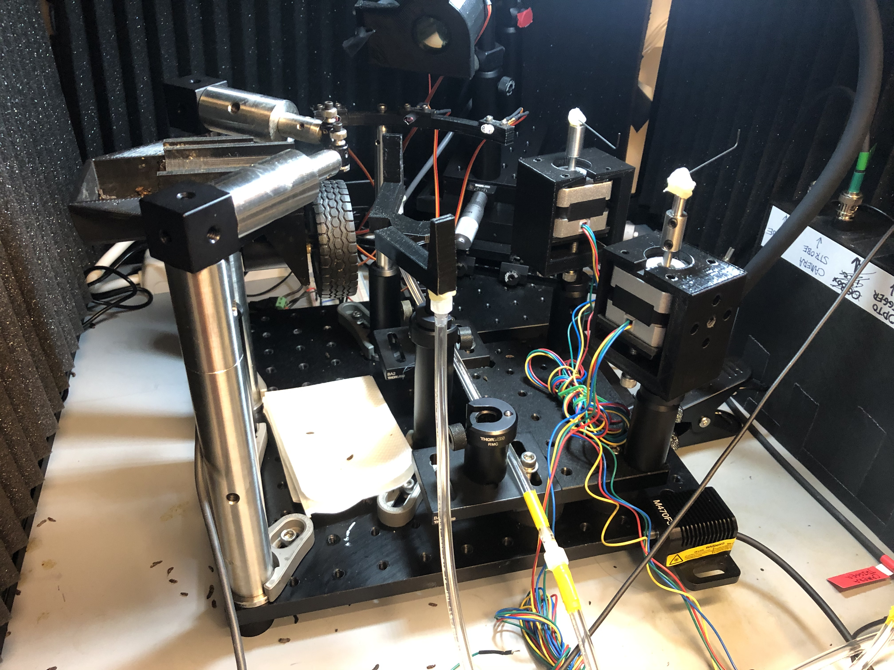
Configured for whisker stimulation

Slide 3
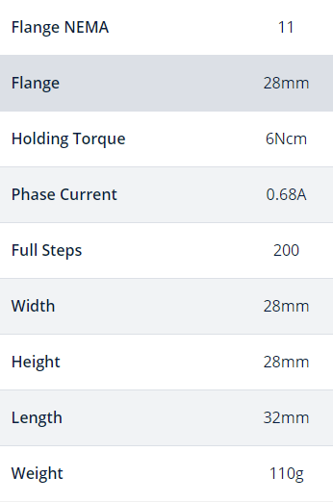
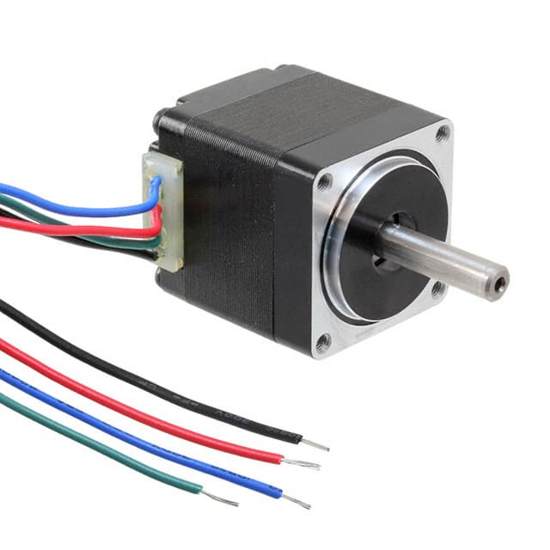
Stepper motor
Trinamic QSH2818-32-07-006
https://www.trinamic.com/products/drives/stepper-motors-details/qsh2818/
https://www.digikey.com/en/products/detail/trinamic-motion-control-gmbh/QSH2818-32-07-006/4843423

Slide 4
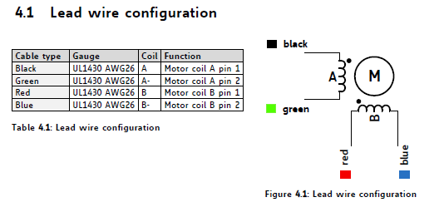
Stepper motor
G k r b

Slide 5
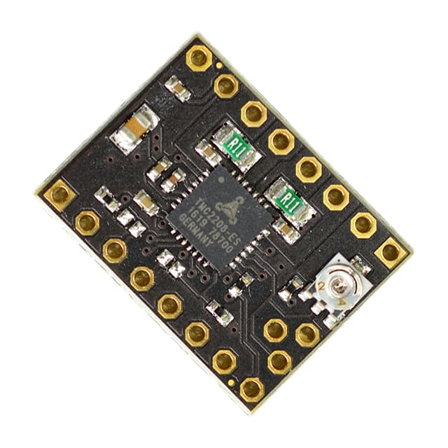
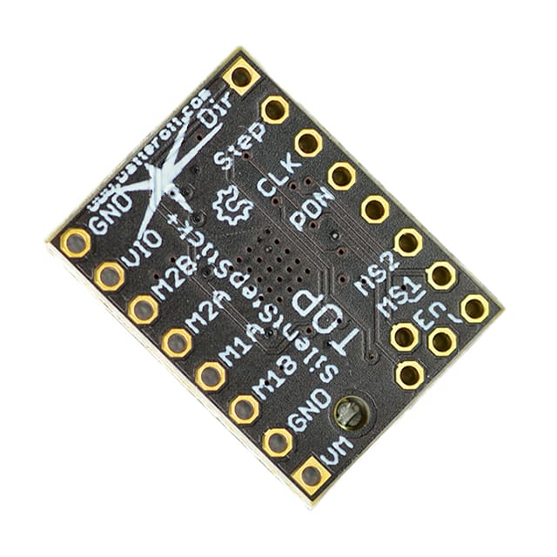
Driver
TMC2208 SilentStepStick
https://www.trinamic.com/support/eval-kits/details/silentstepstick/
https://www.digikey.com/en/products/detail/trinamic-motion-control-gmbh/TMC2208-SILENTSTEPSTICK/6873626

Slide 6
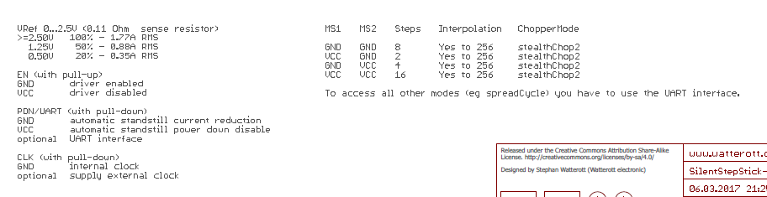
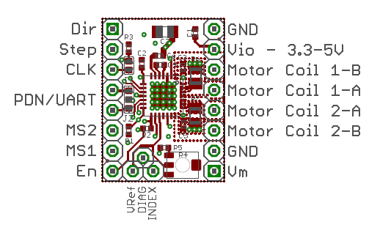
Driver
Motor power supply: 5.5-36V

Slide 7
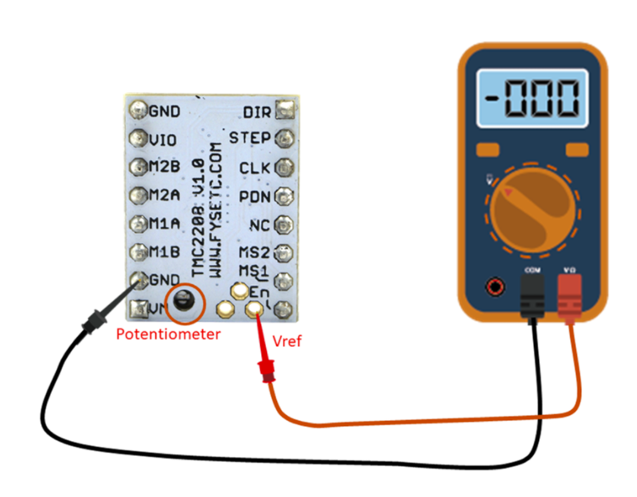
Driver: setting the motor current
Check the motor current rating (0.68A phase current). The driver’s Irms output should not exceed this value.
The Irms output of the driver can be measured the Vref point. For this driver, the relationship is Vref = (Irms * 2.5V) / 1.77A. Vref should therefore not exceed 0.96V, but a safer value would be 90% of this value (0.86V)
3) With the motor disconnected from the driver, measure the Vref value on the driver and adjust the pot until it reads the desired value

Slide 8
Step size
200 full steps 🡪 1.8 deg/step
3200 microsteps (@ 16 microsteps) 🡪 0.1125 deg/microstep
200 microsteps = 22.5 degrees

Slide 9
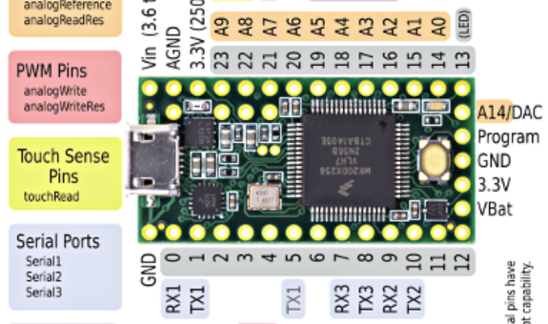
Wiring
5.5-36V
>1.4A
(I use 9V, 2A supply)

